Slide 1
Angles & Their Measure
Trigonometry

Slide 2
Initial Side, Terminal Side, & Standard Position
Initial side – start side of angle
Terminal side – end side of angle
Standard position – An angle whose initial side is on the positive x-axis.
What would a non-example be?

Slide 3
Radians & Degrees
Angle measures can also be expressed in radians or degrees.
A radian is the ratio of the length of an arc to its radius
Radians can take 2 forms – an exact answer and an approximate decimal answer
The exact answer has a in it and it is the usual way to see radians

Slide 4
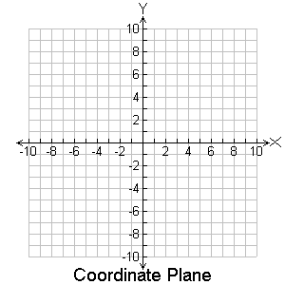
Positive Angles & Negative Angles
Positive Angle – an angle in standard position that rotates counterclockwise.
Negative Angle – an angle in standard position that rotates clockwise.

Slide 5
Quadrants
To find out what quadrant an angle is in…
- Make a negative angle positive by adding 360º or 2π (may need to do multiple times)
- If angle is bigger than 360º or 2π, make it smaller by subtracting 360º or 2π (may need to do multiple times)
Quadrant II
Quadrant I
Quadrant III
Quadrant IV

Slide 6
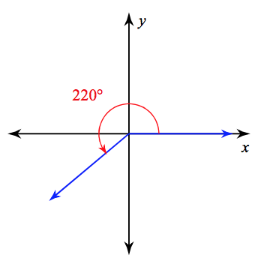
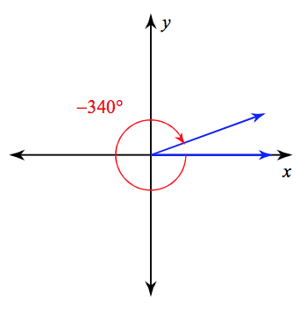
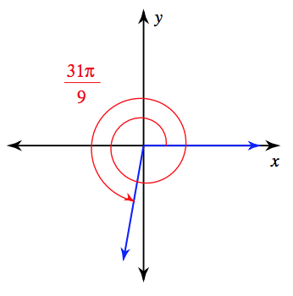
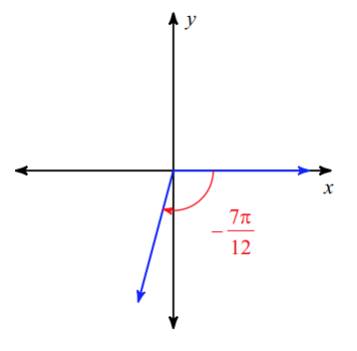
What Quadrant Is It In (And Sketch)?
1) 220º 2) -340º
5) 31𝛑/9 6) -7𝛑/12

Slide 7
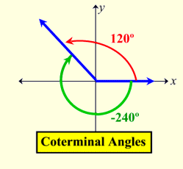
Coterminal Angles
Angles that have the same terminal side.
You add or subtract multiples of 360º (or 2π) to find coterminal angles.

Slide 8
Find a positive and negative coterminal angle
9) -60º 10) 310º
300; -420 670; -50
13) 3𝛑/16 14) -4𝛑
35𝛑/16; -29𝛑/16 2𝛑; -6𝛑

Slide 9
Complementary Angles & Supplementary Angles
Complementary angles add up to 90º (or π/2 for radians).
Supplementary angles add up to 180º (or π for radians)
A
B
B
A
A + B = 90∘
A + B = 180∘

Slide 10
What angle is complementary/supplementary to?
Complementary
Supplementary
36º
54º
𝛑/5
3𝛑/10
110º
70º
3𝛑/4
𝛑/4

Slide 11
Reference Angles
A reference angle is the acute angle that an angle makes with the x-axis.
The reference angle is always positive

Slide 12
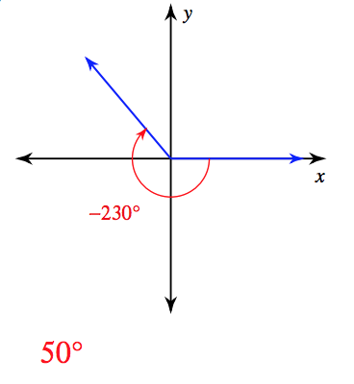
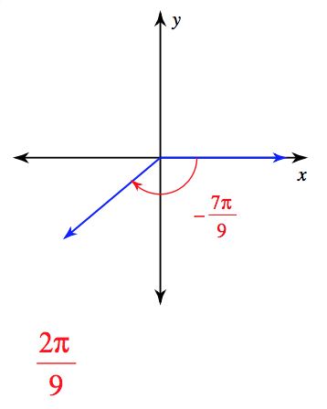
Find The Reference Angle
25) -230º 27) -7𝛑/9

Slide 13
TOD
321
Write 3 new things you learned
Write 2 vocabulary words with their meaning
Write 1 thing you don’t understand

